Slide 1


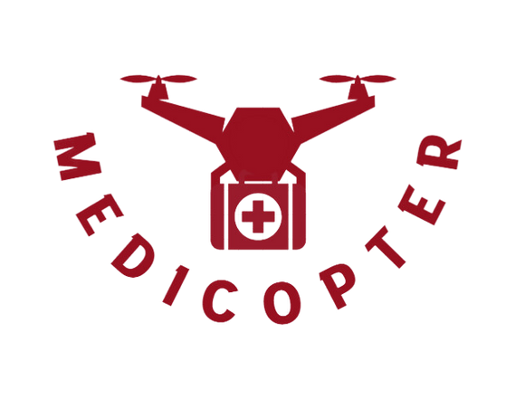
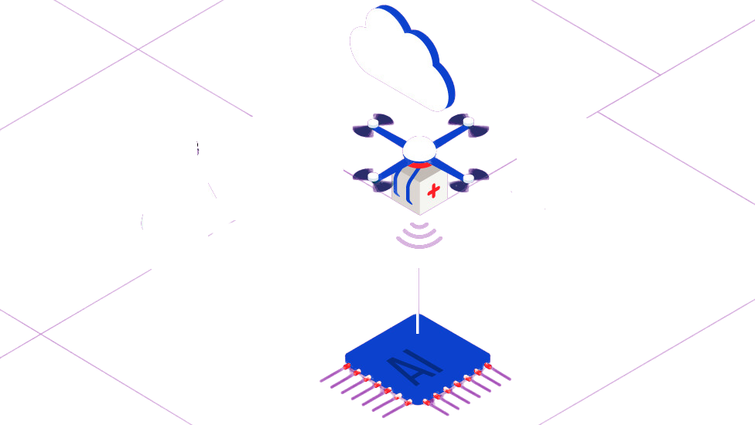



MEDICOPTER
Logistic system using drones to deliver medical supply
CiC 2023

Slide 2


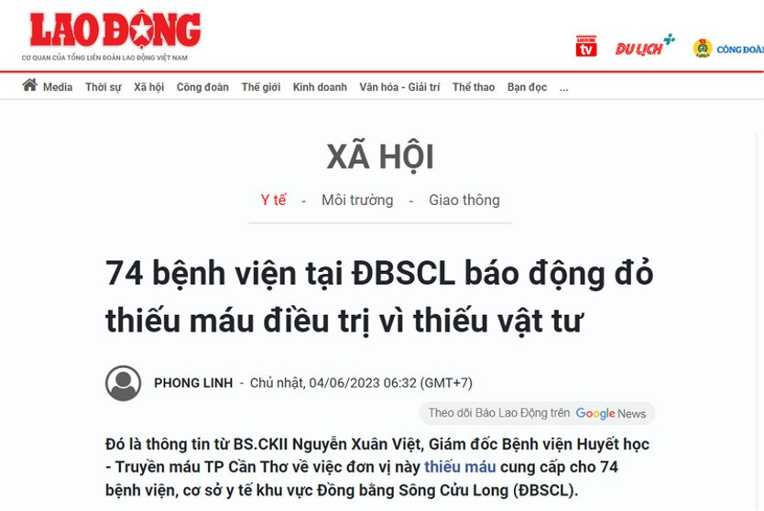
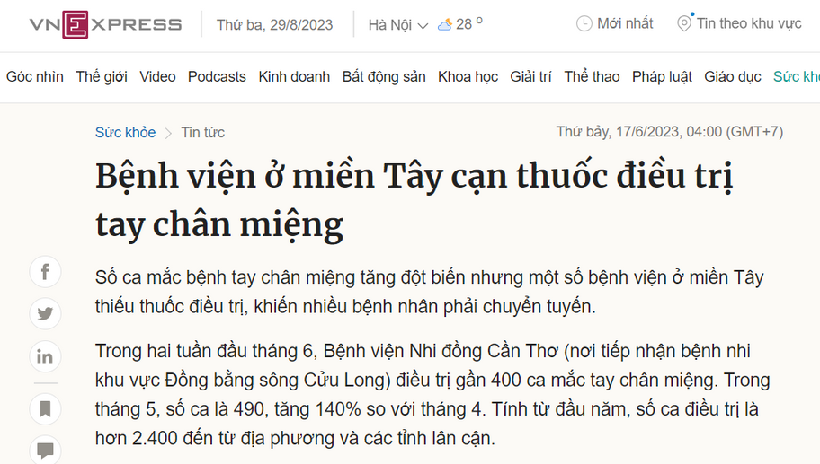
PROBLEM
MEDICOPTER
Currently, 74 (44%) hospitals in Mekong Delta lack of medical supplies and blood samples.
(*) According to General Statistics Office of Vietnam 2017

Slide 3


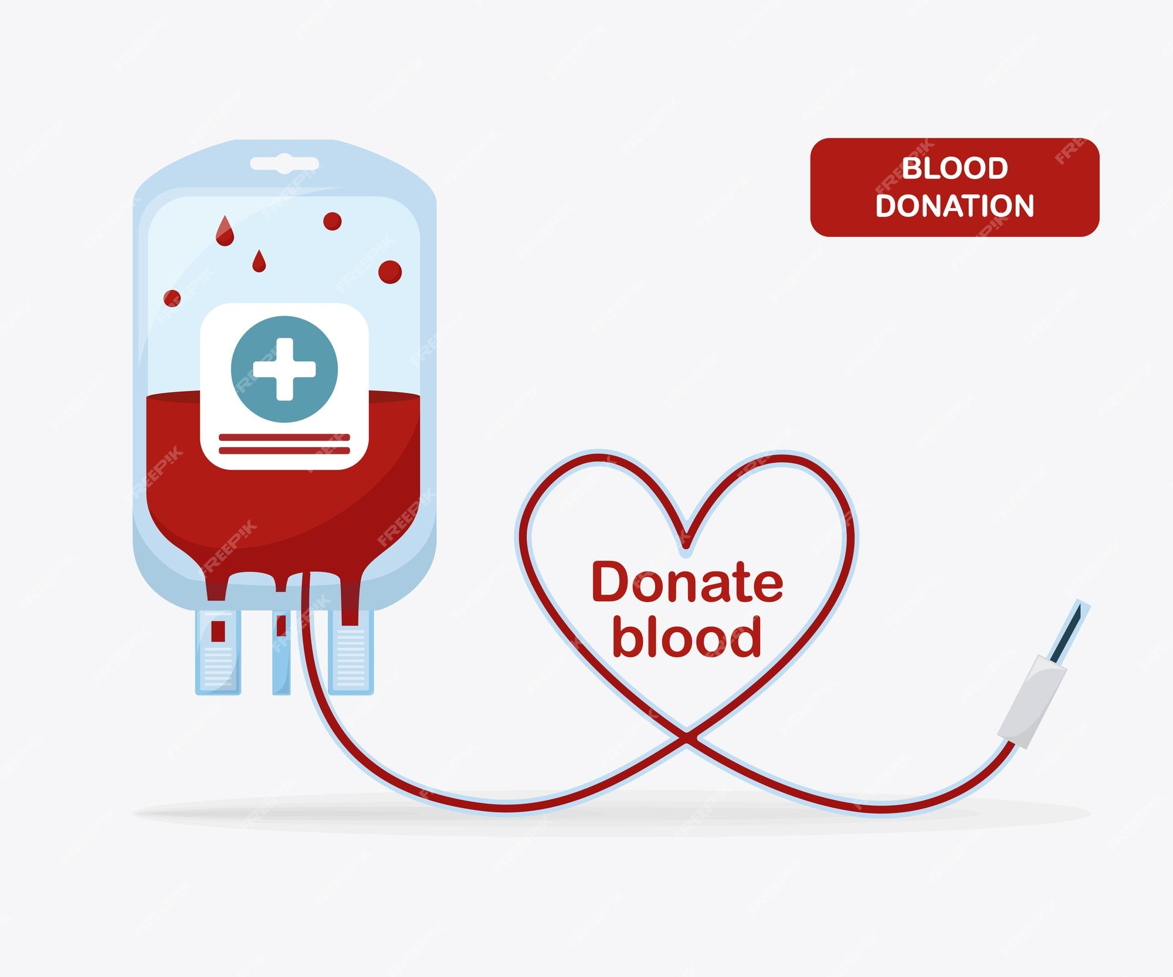
PROBLEM
MEDICOPTER
BLOOD BANK
HIGH PRESERVATION COST
BAD ROAD
LONG TIME
SHORT
EXPIRY DATE

Slide 4
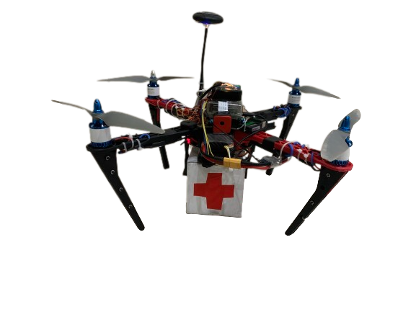




SOLUTION
MEDICOPTER
Use Drone to delivery medical supplies from hospitals to hospital on demand
Compare to ambulance
Faster
20% shorter distance^{(*)}
Less CO2
First drone made by us
(*) From Blood Transfusion Haematology Hospital in HCM to Can Tho Hospital

Slide 5
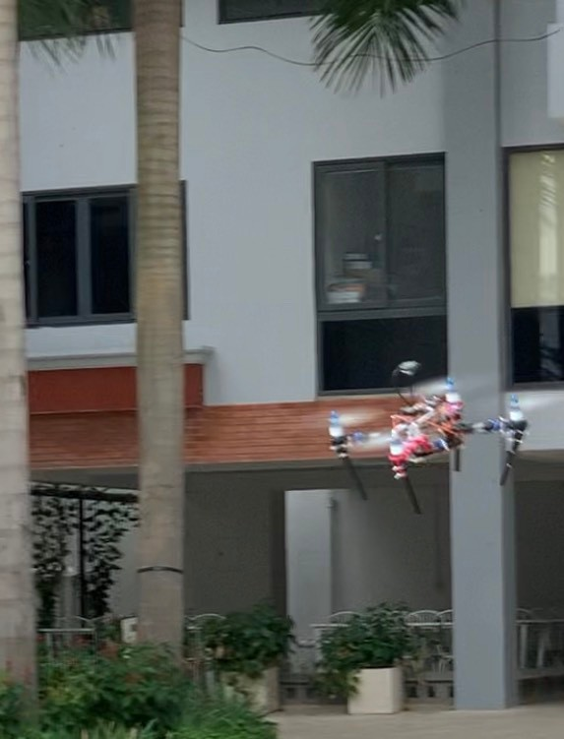
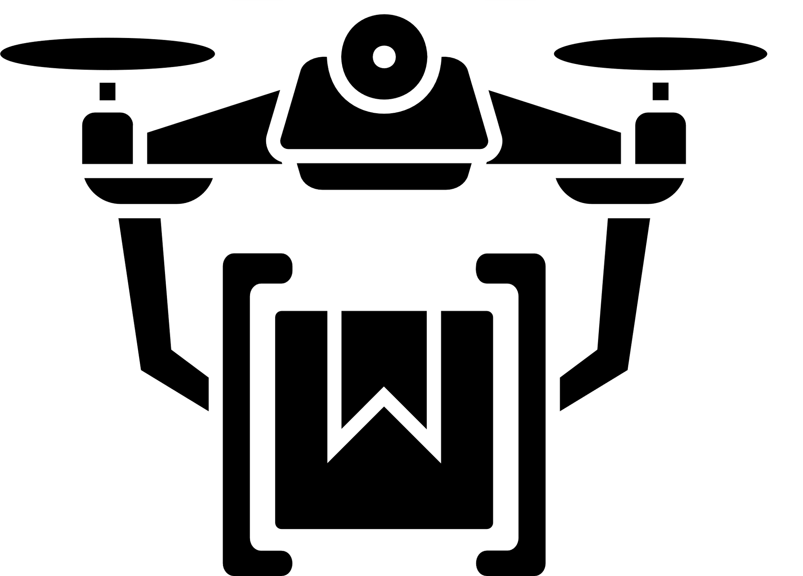
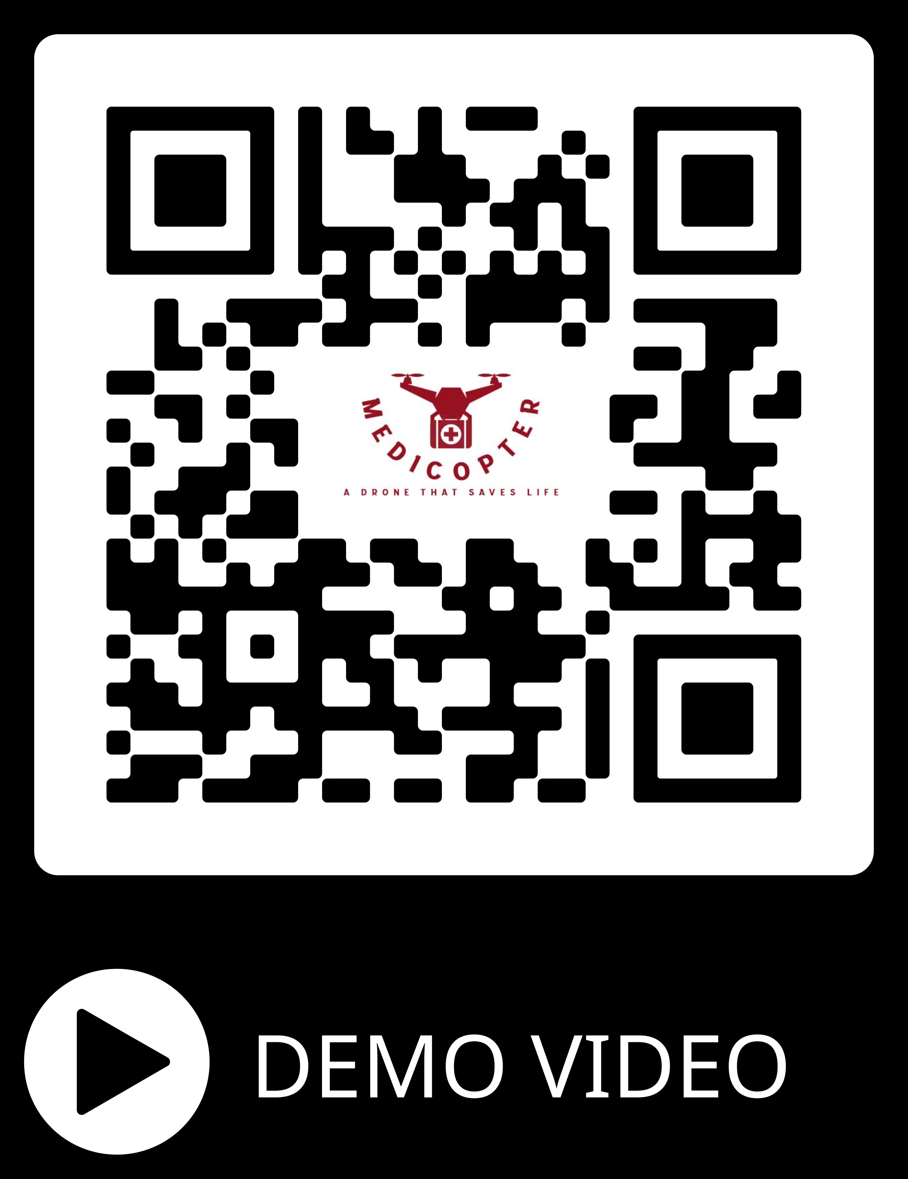

PROTOTYPE
MEDICOPTER
Capabilities of our first prototype:
Maximum speed: 60km/h
Maximum payload: 3 kg
Automated

Slide 6
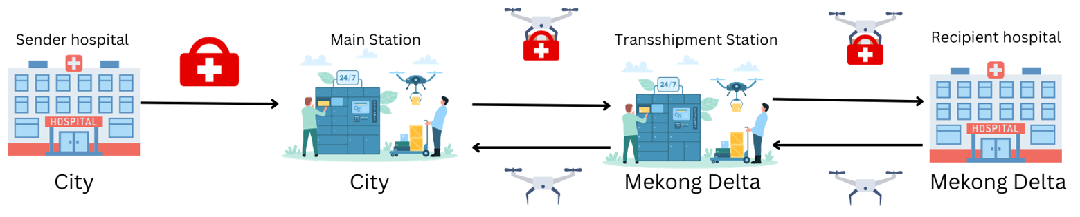
OPERATION MODEL
MEDICOPTER

Slide 7
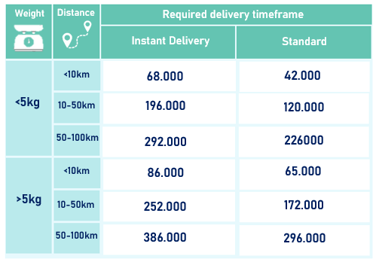
REVENUE MODEL
MEDICOPTER
*Average revenue (Unit: VND)

Slide 8
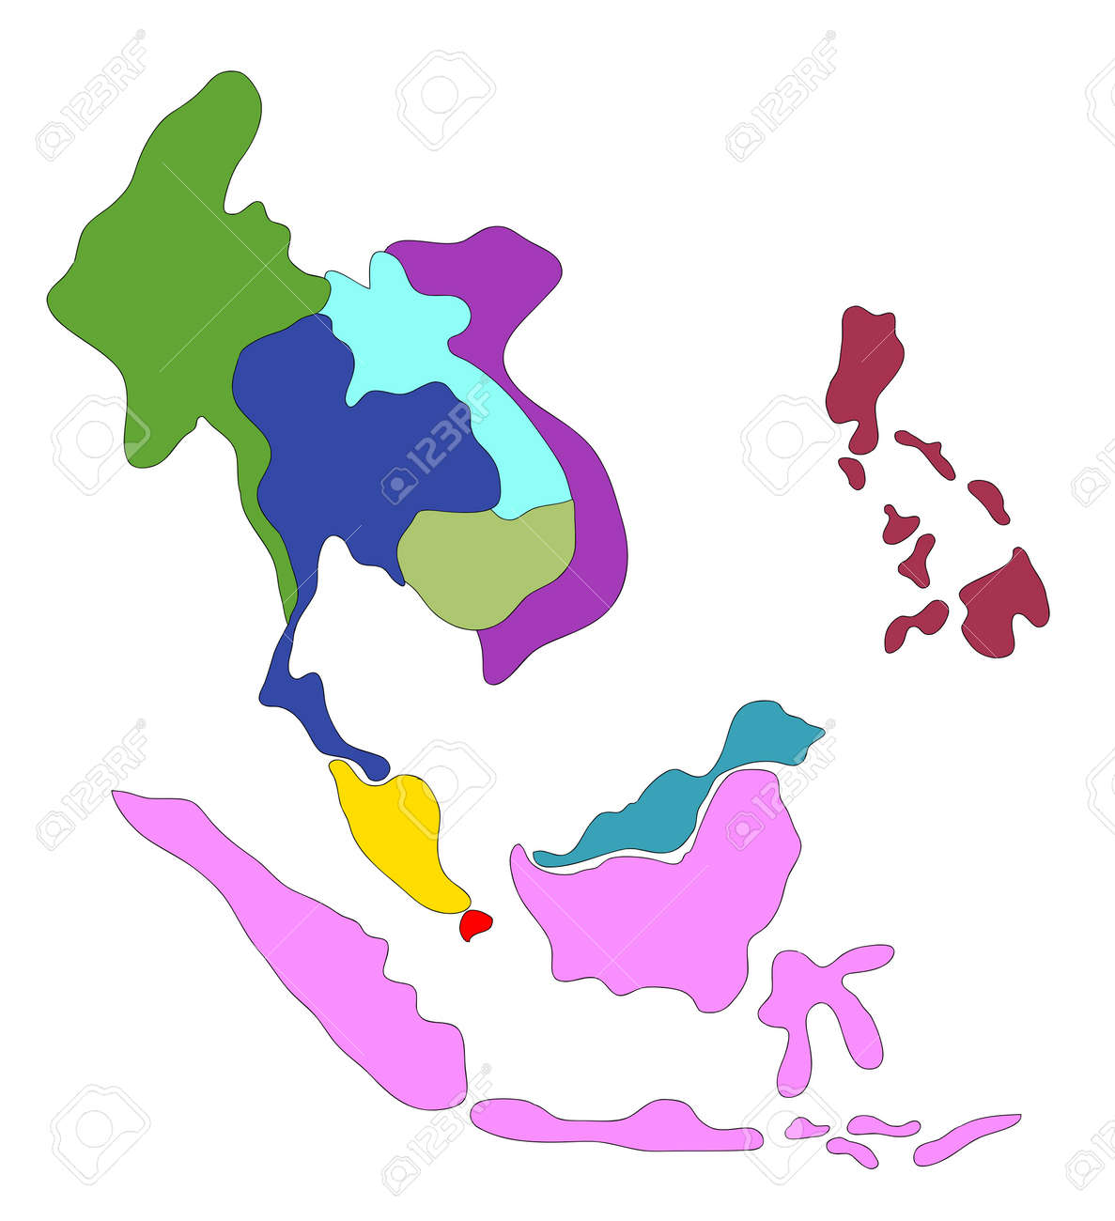
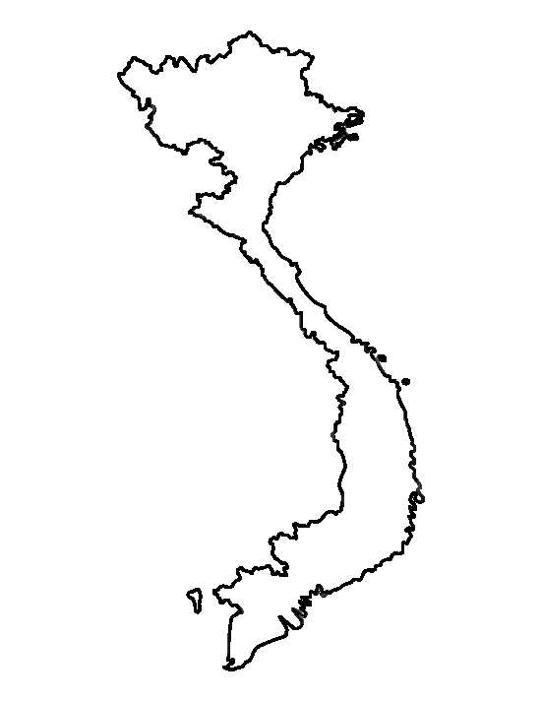
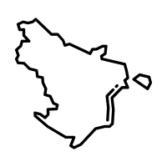
MARKET SIZE
MEDICOPTER
TAM
SAM
TAM
SOM
900 Billion VND
100 Billion VND
ASEAN
10,435 Hospitals
25 Billion VND
Vietnam
1,015 Hospitals
Mekong Delta
169 Hospitals

Slide 9



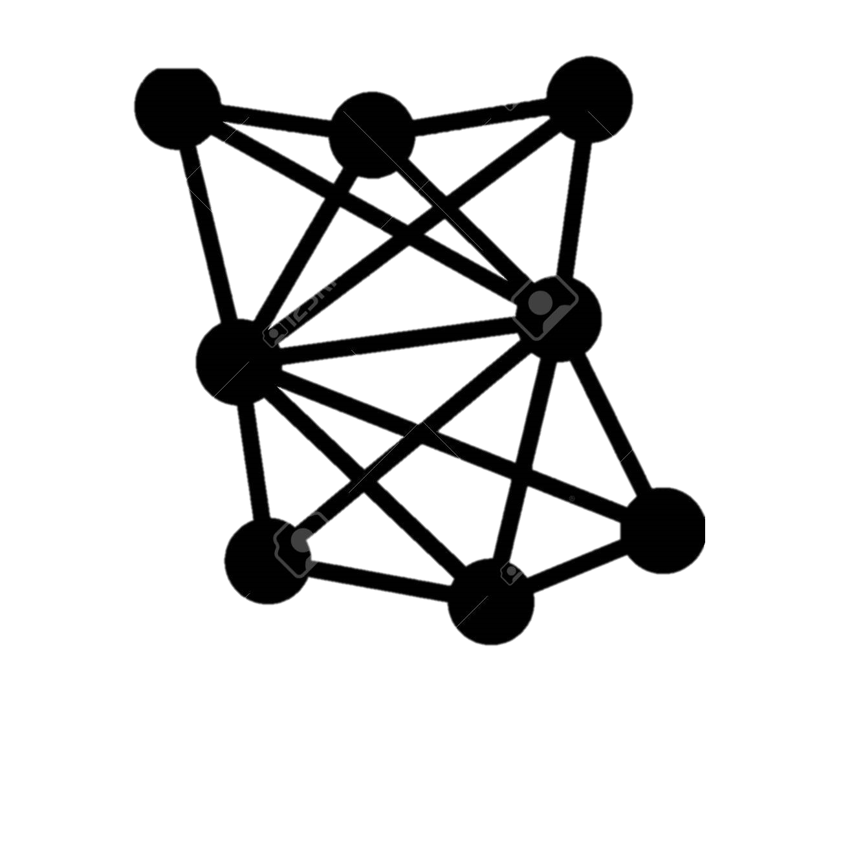




PRODUCT ROADMAP
MEDICOPTER
Develope fixed-wing drone
Final Testings and Launch fixed-wing drone
8/2024-2026
2027
Update AI Automatic flying
Build operation system and testings
4/2024-7/2024
10/2023-4/2024
We are here
Testing first
demo drone
5/2023
6-8/2023
8-9/2023
Propose the idea
Identify theorical basis
Create smart drone

Slide 10

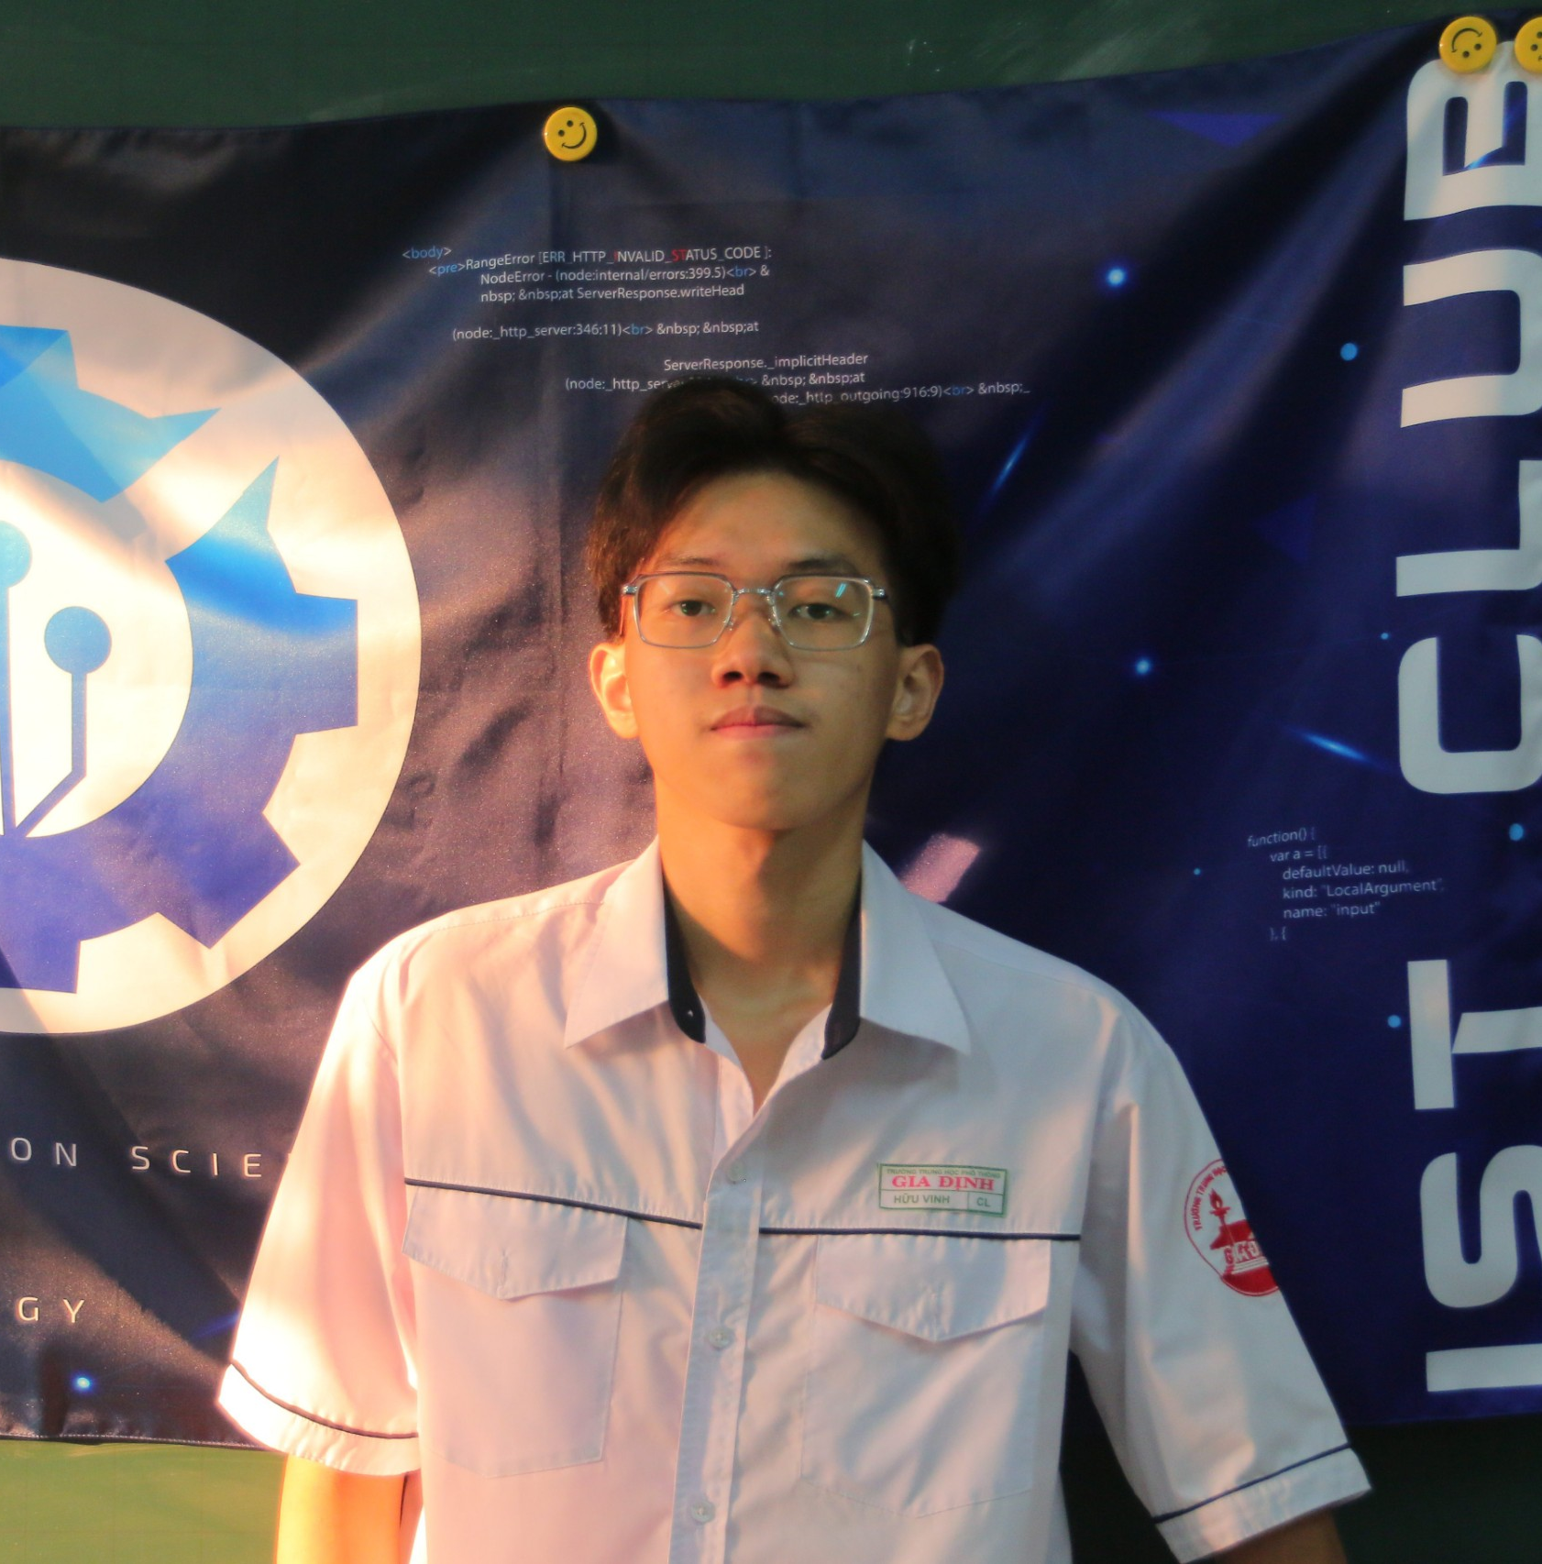
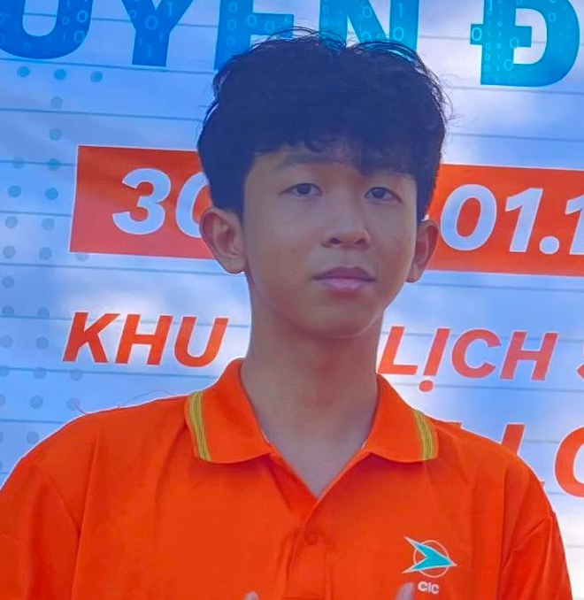

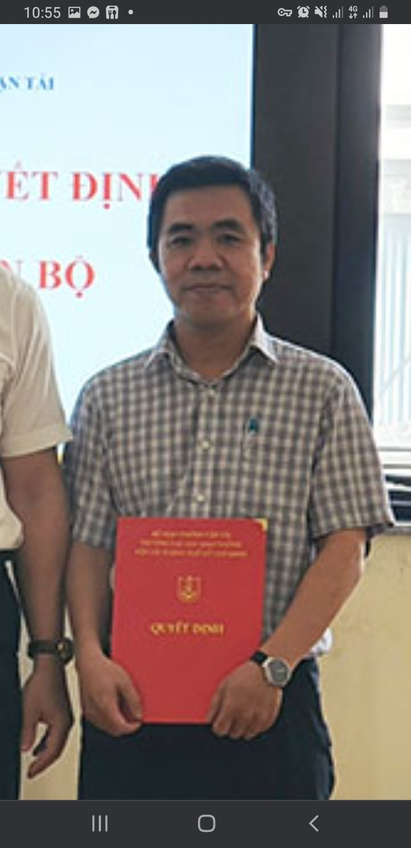


OUR TEAM
MEDICOPTER
About us : Gold medals of AI-JAM US 2023 for project “Drone for Instant Medical Delivery”
Le Minh Quy
Nguyen Huu Vinh
Nguyen Huu Anh Khoa
Leader / Drone R&D Engineer
Drone R&D Engineer
Business
Supporters
Mr. Steven Le
CRO, AirCity
Dr. Dang Nhan Cach
Lecturer, UTH
Dr. Le Dang Khoa
Lecturer, VNU
Bui Manh Gioi
Founder, GioiIELTS Center
Mentor
Technical Advisor
Technical Advisor
Business Advisor

Slide 11
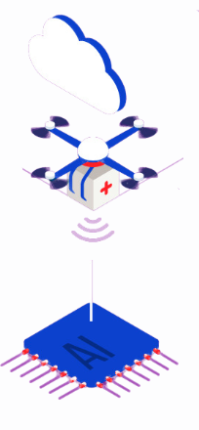
Thank you!
MEDICOPTER

Slide 12
Appendix
MEDICOPTER

Slide 13
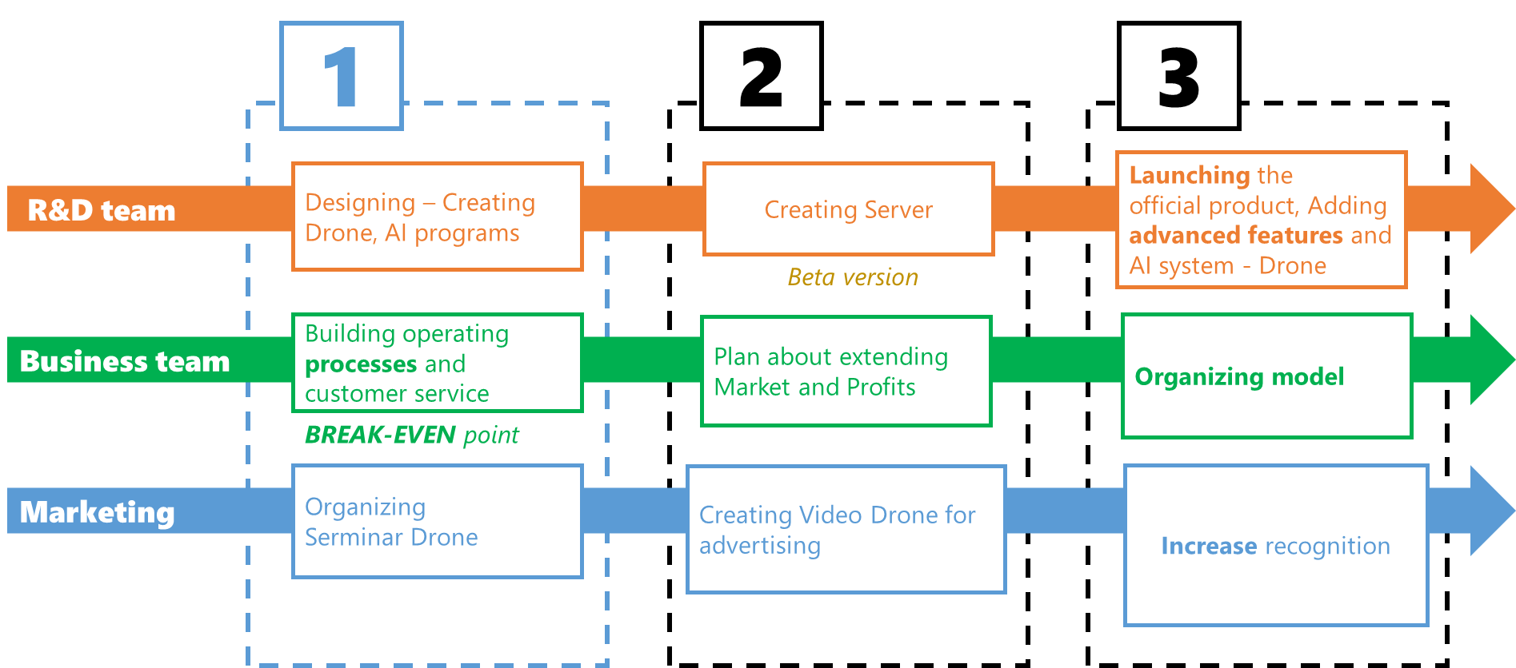
OPERATION PLAN
MEDICOPTER

Slide 14
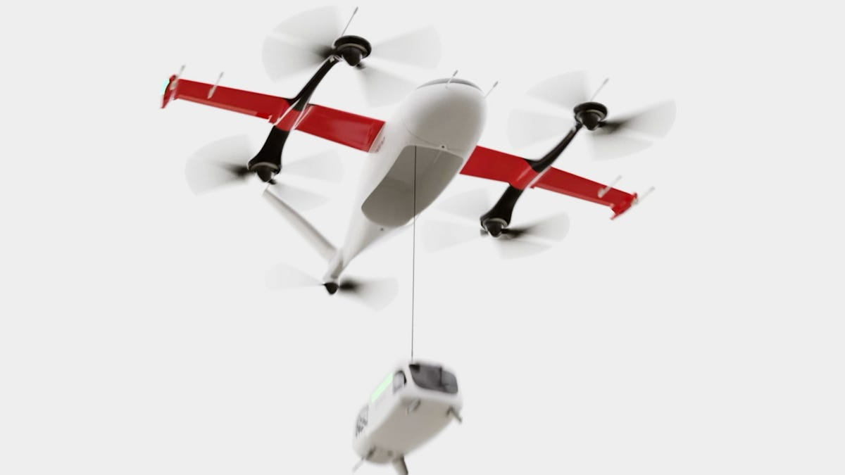

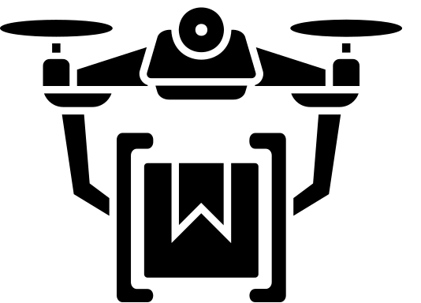


TARGET PRODUCT
MEDICOPTER
Target capabilities of the product:
Maximum speed: 125km/h
Maximum payload: 10 kg
Drone made by Zipline
Up to 1 hour
AI for smart landing and control

Slide 15
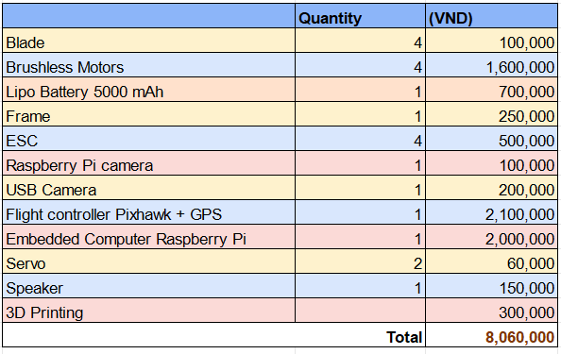
DRONE BASIC COST
MEDICOPTER

Slide 16
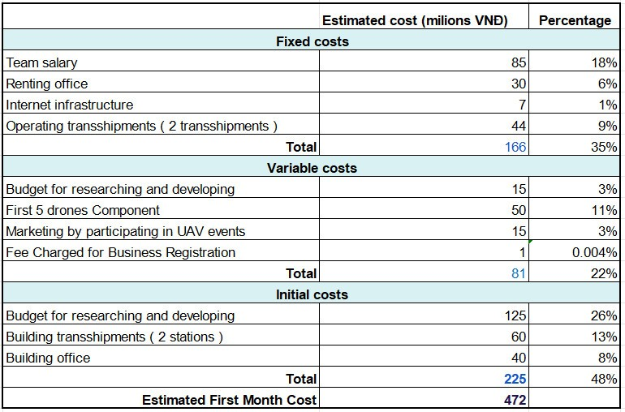
COST STRUCTURE
MEDICOPTER

Slide 17
SWOT Analysis
MEDICOPTER
STRENGTHS
OPPORTUNITIES
Smart model Drone with effective agorithms and AI for detecting.
Cost Drone is low
Founding members are well-suited
There are currently no project medical Drone in ASEAN
First model medical delivery by Drone in Viet Nam
WEAKNESSES
THREATS
Lack of business experience
Limited capital
Lack human resource
Drone is tested in many place in the world and more companies in the future

Slide 18
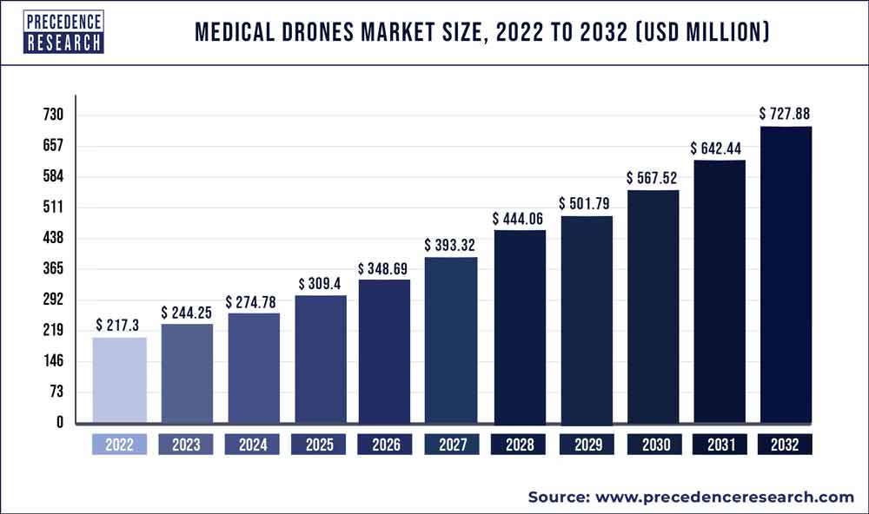
GLOBAL MARKET SIZE
MEDICOPTER

Slide 19



FUTURE INVESTORS
MEDICOPTER
Government
Venture capital investment
Health care Funds

Slide 20
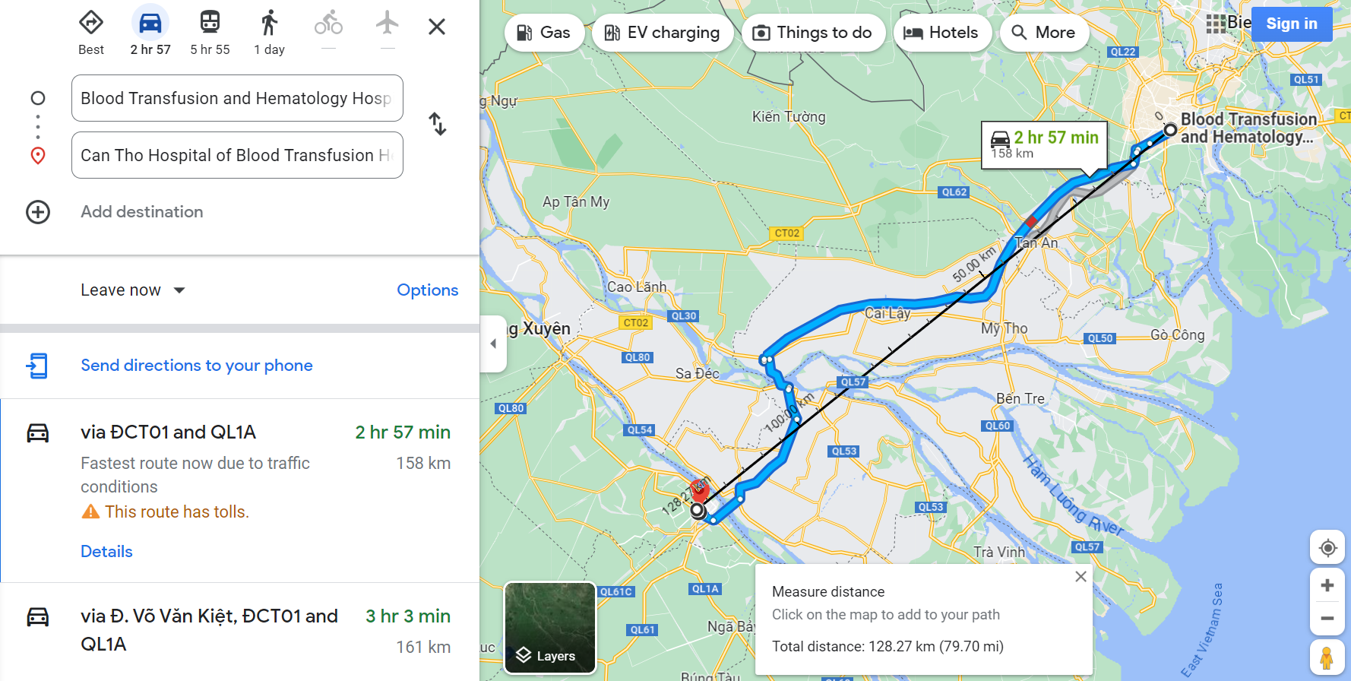
HOW DRONE TRAVEL SHORTER
MEDICOPTER

Slide 21
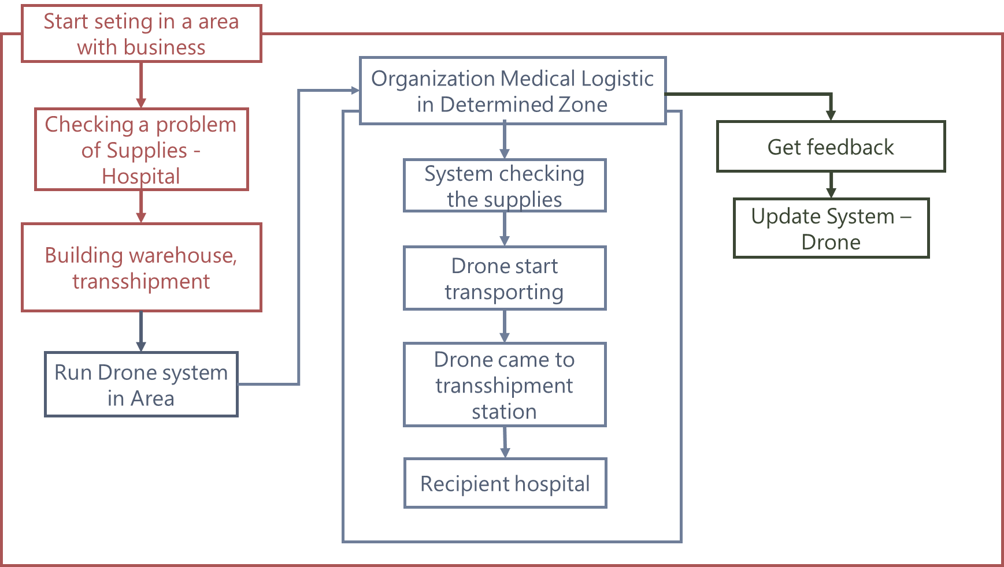
OPERATION PROCESS
MEDICOPTER

Slide 22
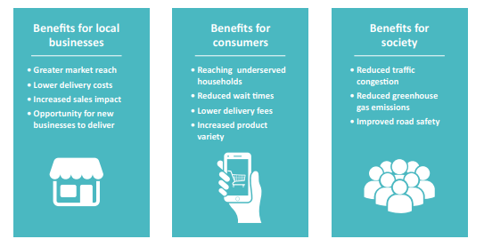
BENEFITS
MEDICOPTER

Slide 23
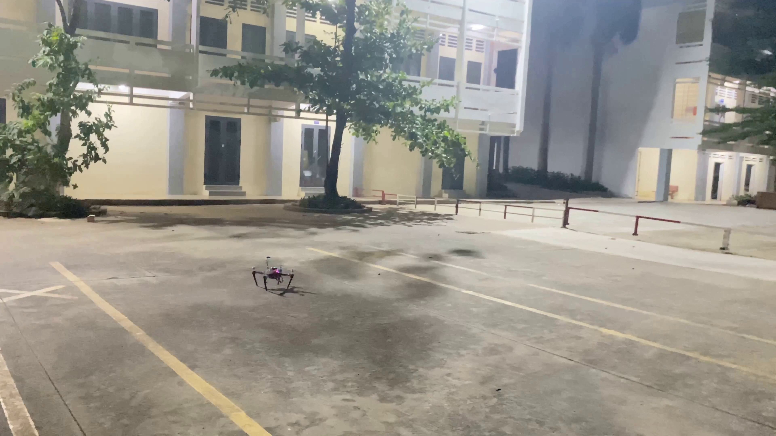
DEMO VIDEO
MEDICOPTER

